Slide 1
MYP PERSONAL PROJECT
An overview of the new guide

Slide 2

FOCUS
“People think focus means saying yes to the thing you’ve got to focus on. But that’s not what it means at all. It means saying no to the hundred other good ideas that there are. You have to pick carefully.” Steve Jobs

Slide 3
MYP PROJECTS
The Personal Project
The personal project encourages students to practice and strengthen their approaches to learning (ATL) skills, to consolidate prior and subject-specific learning, and to develop an area of personal interest.
The personal project provides an opportunity for students to produce a truly personal and often creative product/outcome and to demonstrate a consolidation of their learning in the MYP.

Slide 4
MYP PROJECTS 2
The project offers many opportunities for differentiation of learning and expression according to students’ individual needs.
MYP projects are student-centered and age-appropriate, and they enable students to engage in practical explorations through a cycle of inquiry, action and reflection. skills, to consolidate prior and subject-specific learning, and to develop an area of personal interest.

Slide 5
The Personal Project is…
A personal inquiry into issues relevant to the student
A demonstration of the skills, attitudes and knowledge acquired during their time in the MYP – a culminating activity
An opportunity to discover new strengths and develop characteristics of the Learner Profile

Slide 6
EXPECTATIONS
Your child is expected to:
• document his or her process
• select a topic of personal interest
• focus the Personal Project through an area of interaction
• structure the Personal Project report according to the information provided
• respect word or time limits for the report
• fulfill ethical and academic honesty requirements established by the school.

Slide 7
Aims of the Personal Project
The aims of the MYP projects are to encourage and enable students to:
participate in a sustained, self-directed inquiry within a global context
generate creative new insights and develop deeper understandings through in-depth investigation
demonstrate the skills, attitudes and knowledge required to complete a project over an extended period of time
communicate effectively in a variety of situations
demonstrate responsible action through, or as a result of, learning
appreciate the process of learning and take pride in their accomplishments.

Slide 8
personal project objectives 1
Objectives
The objectives of the Personal Project state the specific targets that are set for learning.
They define what each child will accomplish as a result of completing the Personal Project.
These objectives relate directly to the assessment criteria.

Slide 9
THREE COMPONENTS of the personal project
Focus on a topic leading towards a product/outcome…seen in the presentation/report
The Process Journal…a selection of extracts in the appendices of the report
The Report…the content of the report assessed using the 4 criteria

Slide 11


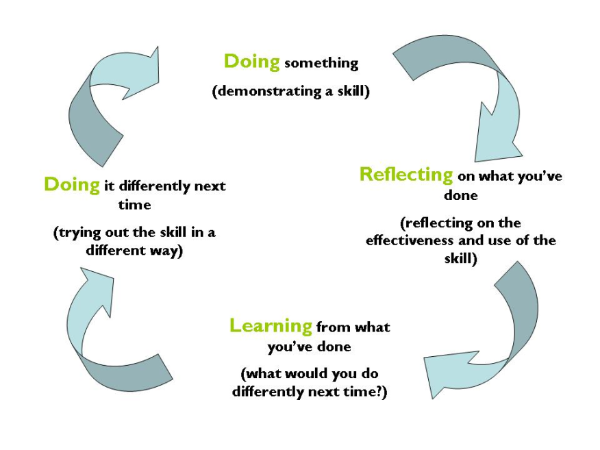
Key Components of the Personal project
Inquiry…
Action…
Reflection…

Slide 12
Students must identify ONE of the global contexts for their project, to establish the relevance of their inquiry
(why it matters).
Students should consider the following when choosing a global context through which to focus their project.
• What do I want to achieve through my personal project?
• What do I want others to understand through my work?
• What impact do I want my project to have?
• How can a specific context give greater purpose to my project?

Slide 13
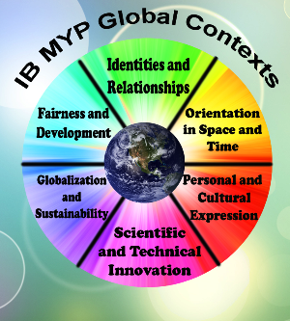

Slide 14
Global Contexts and the
Personal Project
Global contexts direct learning towards independent and shared inquiry into
our common humanity and shared guardianship of the planet. Using the
world as the broadest context for learning,
MYP projects can develop meaningful explorations of:
• identities and relationships
• orientation in space and time
• personal and cultural expression
• scientific and technical innovation
• globalization and sustainability
• fairness and development.

Slide 15
Sample Personal Project Topic Outline
Topic | Global Context | Product/Outcome | How will they achieve it?
Investigate Human Trafficking of Teenage Girls in Croatia and Southern Europe: A Visual Presentation | 1. Globalization and Sustainability 2. Fairness and Development | Brochure/Video/Slideshow to raise awareness of the dangers of this industry and safety rules to abide by | Raise awareness through a campaign Contact through local/regional organizations Survey Contact UN internationally and locally Interview an aid organizer/expert in the field

Slide 16
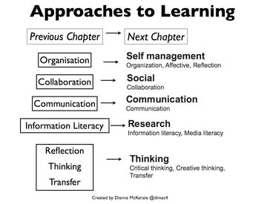
Approaches to learning
MYP projects are culminating activities through which students present,
in a truly personal way, their development of ATL skills.
2. Amongst other things: students should demonstrate how they have met the objectives through their presentation or report at the end of the project.
3. They are expected to communicate clearly, accurately and appropriately,
utilizing communication, organization and reflection as ATL skills.

Slide 17
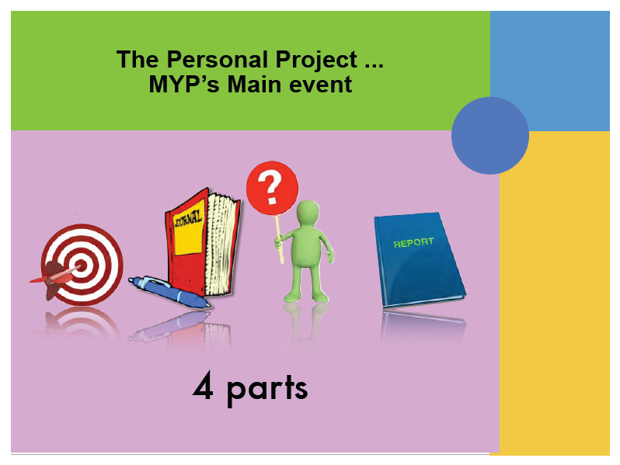

Slide 18
THE PROCESS JOURNAL
Can be different formats
Incorporates ATL skills
Used throughout process to record ideas, planning, reflections

Slide 19
THE PRODUCT OR OUTCOME
A representation of the project
Can be different formats: video, website, event, essay, creation, performance, work of art, etc
Assessed by supervisor…standardization used but ultimately supervisor makes the final decision

Slide 20
THE REPORT
Aims to inform as clearly and succinctly as possible.
Student reflects on and records the process
Can be different formats – written or spoken
written report min 1500, max 3500 words
Visual/film 13-15 minutes

Slide 21
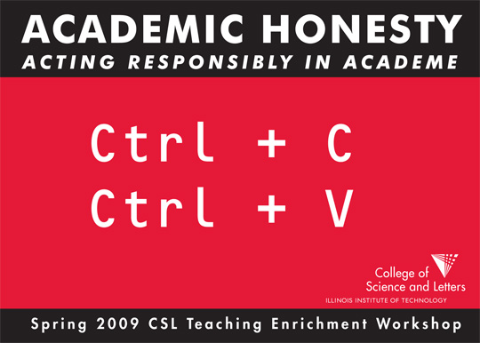
Students and their supervisors must use the academic honesty form provided by the IB.
Add meeting dates and the main points discussed
Declare the academic honesty of the work.

Slide 22
REMINDER to students
Review the AUP
Ensure they use MLA format when referencing sources
Stress academic honesty – seriousness of plagiarism

Slide 23
ASSESSMENT CRITERIA
Assessment for the MYP personal project is criterion-related, based on four equally
weighted assessment criteria.
Criterion A Investigating Maximum 8
Criterion B Planning Maximum 8
Criterion C Taking action Maximum 8
Criterion D Reflecting Maximum 8
MYP personal projects must address all strands of all four assessment criteria.

Slide 24
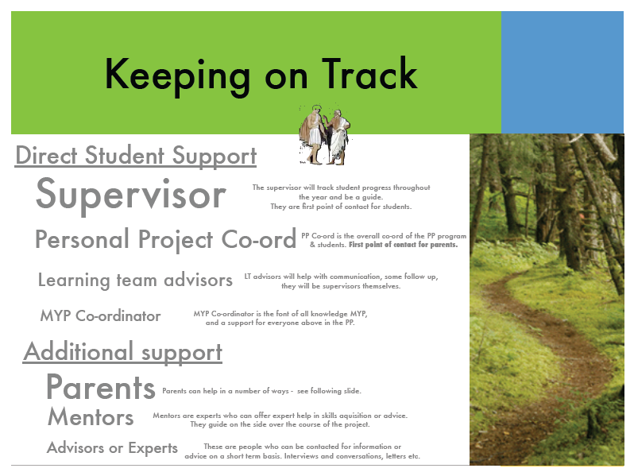

Slide 25
SUPERVISOR’S ROLE
• make sure the chosen MYP project topic satisfies appropriate legal and ethical standards with regard to health and safety, confidentiality, human rights, animal welfare and environmental issues
• provide guidance to students in the process and completion of the project
• confirm the authenticity of the work submitted
• assess the MYP project using the Personal Project criteria
• participate in the standardization of assessment process established by the school

Slide 26
The Role of the Librarian
As well as outside specialists and teachers the librarian is a key resource for students in the process of completing the project.
The librarian is able to assist students with research skills and with locating and sourcing resources, as well helping with areas such as referencing and completing bibliographies.

Slide 27

MYP 5 THIS YEAR
There are 40 students
Supervisors from Georgian and English Departments will be used
Preferably no more than 2 students per supervisor

Slide 28
Academic Honesty
in the Personal Project

Slide 29
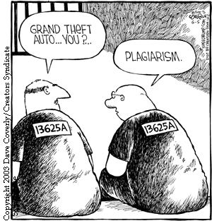
Academic Honesty in the Personal Project
When researching a piece of work questions students can ask:
When is using someone else’s work or ideas RESPECTFUL and when is it PLAGIARISM?
Can research help me to better
understand perspectives?
What is the line between respecting
intellect and respecting the
intellectual property of others?
What does it mean to be principled?
How can I maintain my integrity as an MYP student when conducting my research?
I want to be responsible for what I write and how I write it-does referencing others’ work mean mine isn’t as valuable?

Slide 30



Slide 31
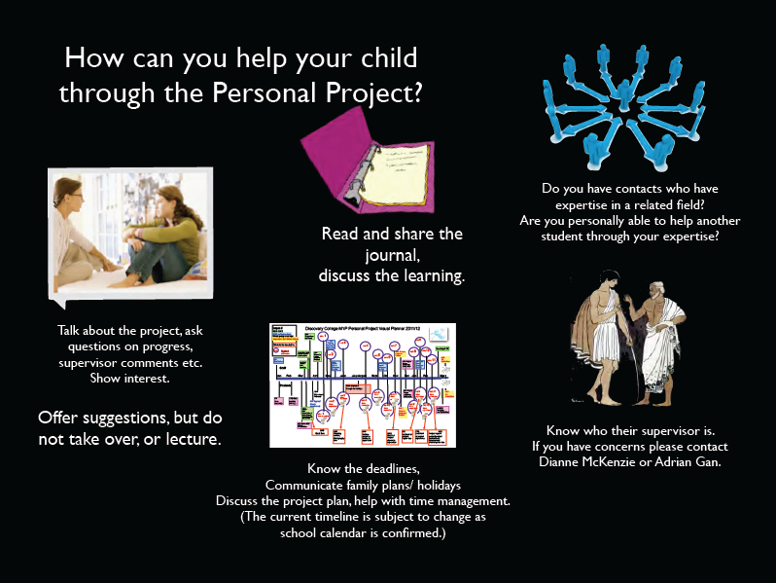

Slide 32
Where to find the handbook and extra information
http://newschoolpersonalproject.weebly.com

